Slide 1



Android Healthcare project
Name :- Heli Acharya - 205190686054 , Tanvi Gohel - 205180686057
Group :- 8
Date：19-12-23

Slide 2

Contents
01/Login
02/Registration
03/Lab Test
04/Medicine
05/Find Doctors
06/Health Articles
07/Order Details
08/Logout

Slide 3
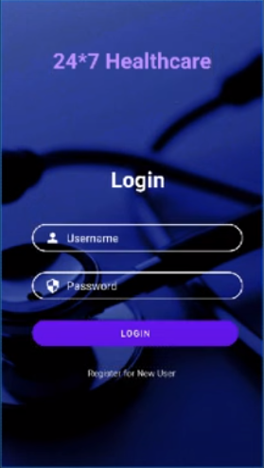
Login
Components :
- Login text box
- Username Input box
- Password Input box
- Login Button
- Register link and Text

Slide 4

Login
Take the input from user for username field
On the On- Click of Login Button it will show the toast message
Take the input from user for password
On the On- Click of register link it will redirect to Register Activity

Slide 5
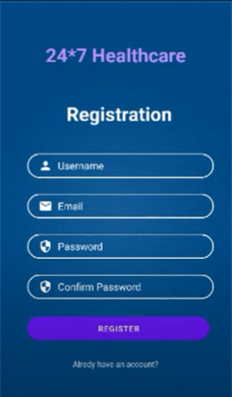
Register
Components :
- Register text box
- Username Input box
- Email Input box
- Password Input box
- C-Password Input box
- Register Button
- Login link and Text

Slide 6
Register
Take the input from user for username and email field
On the On- Click of Register Button it will show the toast message and all data is send to databasae.
Take the input from user for password and confirm password
On the On- Click of already account link it will redirect to login Activity

Slide 7
After Register we make a database activity.
This activity is use to store all the informatio from user to sqlite database. sqlite is android inbuilt database.
Location - device file explorer--data--data--package name -- database.

Slide 8
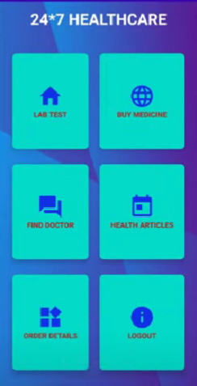
HomeActivity
Components :
- Lab Test Card View
- BuyMedicine Card View
- Find doctor Card View
- Health artcile Card View
- Order detail Card View
- logout Card View

Slide 9
Home Activty
order details will redirect to order activity
On clicking lab - test card view it will redirect to labtest activity
the logout card view will redirect to register activity
The same will be perform for other activity

Slide 10
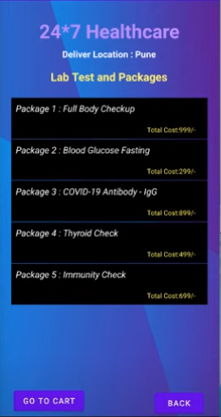
LabTestActivity
Components :
-list of pacakges with cost

Slide 11
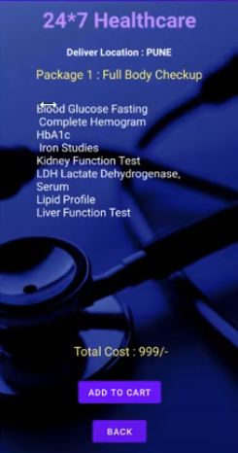
LabTestDetailActivity
Components :
-data of packages and it will redirect to add to cart or back button

Slide 12
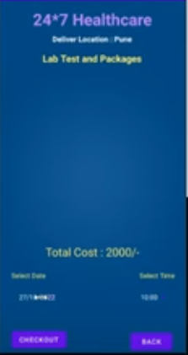
CartLabDetailActivity
Components :
-it will show the cart details and checkout button and back button

Slide 13
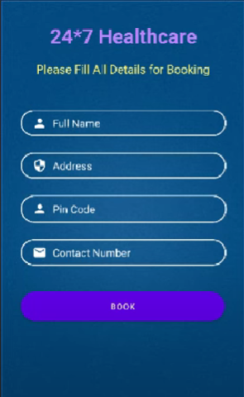
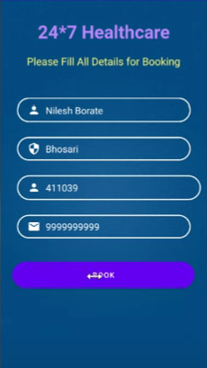
LabTestBookActivity
Components :
-it will show the details to be filled so that you can book.
- and toast message will be shown now to check click the order details card view.

Slide 14
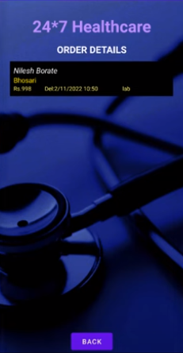
OrderDetailsActivity
Components :
-it will show the orderdetails.

Slide 15
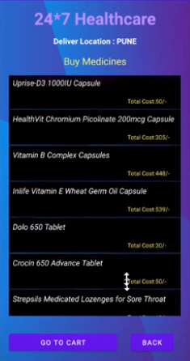
BuyMedicineActivity
Components :
-details to buy the medicine

Slide 16
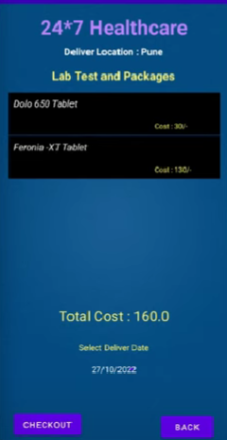
BuyMedicinedetailsActivity
Components :
-details to buy the medicine

Slide 17
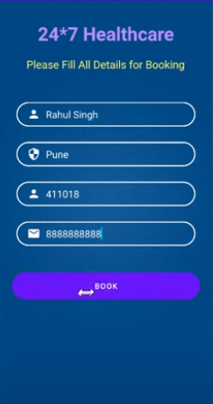
BuyMedicineBookActivity
Components :
-details to fill and then click the book button and it will redirect to order details.

Slide 18
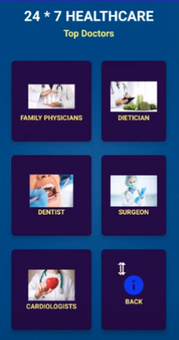
FindDoctorActivity
Components :
- Family Physicians Card view
- Dietician Card view
- Dentist Card view
- Surgeon Card view
- Cardiologist Card view
- Back Card view

Slide 19
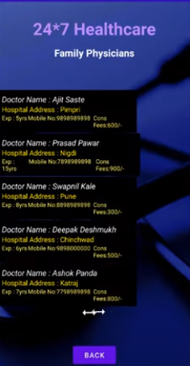
DoctorDetailActivity
Components :
- It will show the details of doctor .

Slide 20
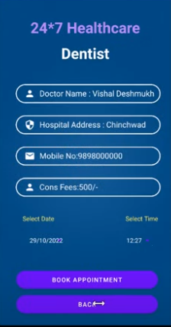
BookAppointementActivity
Components :
- on clicking the doctor detail it will redirect to book appointment .

Slide 21
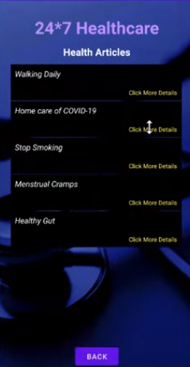
HealthArticleActivity
Components :
- it display various articals and on clicking them it will redirect to healtharticledetail activity.

Slide 22
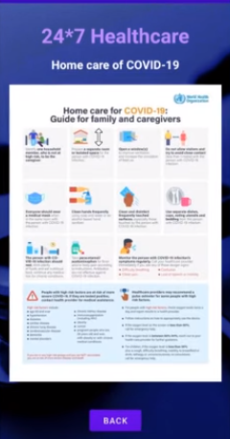
HealthArticleDetailActivity
Components :
- it will show the artical selected from the precious list .

Slide 23
THANK YOU

